Slide 1
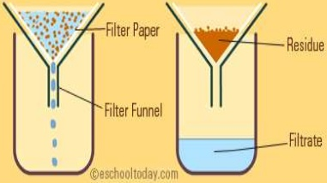
Daily Review
CFU 1
What does a filter do?
Filtration
A filter has holes in it so that it lets small things and liquids through (filtrate), but traps bigger particles (residue).
Write the words that should go in the blanks on your whiteboards.
CFU 2
In your own words, what is a filtrate?
CFU 3
In your own words, what is a residue?
fly screen filtrate: __________ residue: __________
stormwater drain filtrate: __________ residue: __________
tea strainer filtrate: __________ residue: __________
Vocabulary
fil·tra·tion (noun) using a filter to separate the parts of a mixture; also called filtering fil·trate (noun) the substance/s that pass through a filter re·si·due (noun) the substance/s that don’t pass through a filter

Slide 2
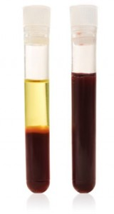
Daily Review
CFU 1
Which parts of a mixture are pulled out the most when it is spun around?
Centrifuging
When a mixture is spun around, the heavier parts of it are pulled outwards more than the lighter parts are.
Spinning a mixture very quickly to separate light and heavy particles is called centrifuging. This is done using a machine called a centrifuge.
CFU 2
Which part of your blood is lighter: the blood cells or the plasma? How do you know?
Vocabulary
cen·tri·fu·ging (noun) spinning a mixture around to separate the heavy parts from the light parts cen·tri·fuge (noun) a machine which spins mixtures around
plasma
whole
blood
blood cells

Slide 3
Separating Mixtures: Distillation Year 7 Science

Slide 4
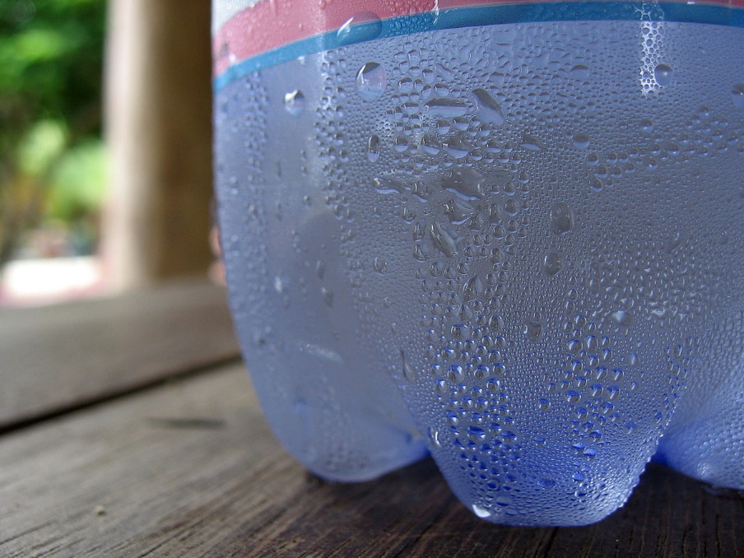
Learning Objectives
CFU
What are we going to learn today?
Define distillation.
Describe how to separate mixtures using distillation.
Explain how a condenser works.
Activate Prior Knowledge
Think, Pair, Share: What needs to happen to a gas to make condensation happen?

Slide 5
Concept Development
CFU 1
What is the difference between evaporation and condensation?
Distillation
Evaporation and boiling are the processes that turn a liquid into a gas.
Condensation is the process that turns a gas into a liquid.
Distillation is a separation technique that uses these processes to separate substances.
CFU 2
What two processes are used in distillation?
evaporation / boiling
Vocabulary
e·vap·o·rate (verb) turn into a gas, usually at the surface of a liquid boi·l (verb) turn into a gas, throughout a liquid
Liquid
Gas
condensation

Slide 6
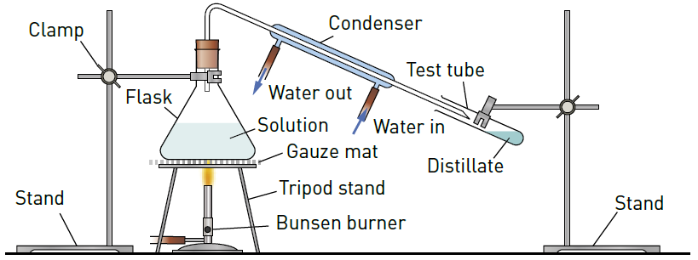
Concept Development
CFU 1
When is distillation used to separate a mixture?
Distillation
When heating a mixture, sometimes you will want to keep the substance that evaporates first.
In distillation the liquid that evaporates into a gas first is condensed back into a liquid so it can be collected.
The evaporated gas is cooled using a condenser.
CFU 2
What happens to the liquid that evaporates first?
Vocabulary
dis·till·a·tion (noun) the process of heating a liquid mixture to form gas then cooling that gas to get a liquid con·den·ser (noun) an apparatus for condensing a gas to form a liquid

Slide 7
Concept Development
CFU 1
Name three pieces of equipment that can be used in distillation.
Distillation
A condenser moves cold water around the tube containing the vapor causing it to condense back into a liquid.
The liquid is then collected and is known as distillate.
CFU 2
Using your own words, explain what distillate is.
CFU 3
What does a condenser do to the gas going through it? What then happens to the gas?
Vocabulary
con·den·ser (noun) an apparatus for condensing a gas to form a liquid

Slide 8
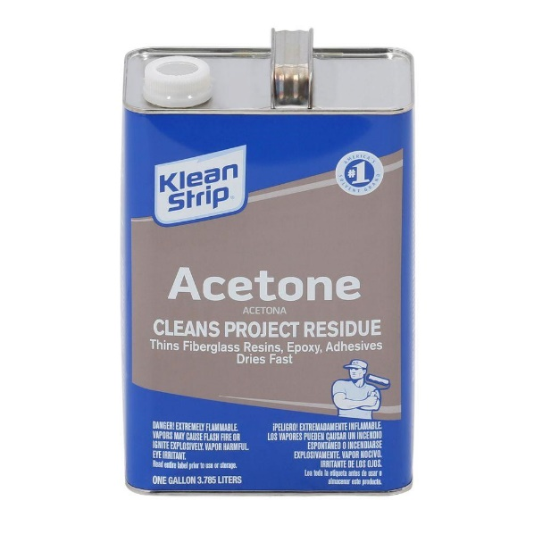
Skill Development/Guided Practice
CFU 1
Does the liquid with the higher or lower boiling point need to be kept?
Which technique?
Jason has accidentally mixed some acetone with water. He needs to use the acetone to clean up some glue he has spilt. If acetone has a boiling point of 56ºC and water 100ºC, which separation technique should he use?
Identifying a separation technique
1. If there is a mixture of liquids with different boiling points, and you want the one with the higher boiling point: evaporation 2. If there is a mixture of liquids with different boiling points, and you want the one with the lower boiling point: distillation
The mixture is a solution and Jason wants to keep the liquid with the lower boiling point, so he should use distillation.
Vocabulary
e·vap·o·ra·tion (noun) heating a mixture of liquids until one liquid turns into a gas, leaving the other liquid behind dis·till·a·tion (noun) heating a liquid mixture to form gas then cooling that gas to get a liquid

Slide 9
Skill Development/Guided Practice
CFU 1
Does the liquid with the higher or lower boiling point need to be kept?
Which technique?
A chemist has found a mixture of chloroform, methanol and sulfuric acid. She only needs to keep the sulfuric acid. What should she do?
The chemist wants to keep the liquid with the highest boiling point, so she should use evaporation.
Identifying a separation technique
1. If there is a mixture of liquids with different boiling points, and you want the one with the higher boiling point: evaporation 2. If there is a mixture of liquids with different boiling points, and you want the one with the lower boiling point: distillation
Vocabulary
e·vap·o·ra·tion (noun) heating a mixture of liquids until one liquid turns into a gas, leaving the other liquid behind dis·till·a·tion (noun) heating a liquid mixture to form gas then cooling that gas to get a liquid
Substance | Boiling Point (°C)
chloroform | 61.2
methanol | 64.7
nitric acid | 83
petrol | 95
sulfuric acid | 337
water | 100

Slide 10
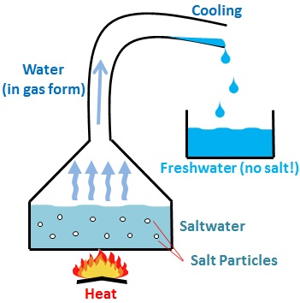
Skill Development/Guided Practice
CFU 1
Does the liquid with the higher or lower boiling point need to be kept?
Which technique?
In some parts of the world seawater is now being turned into drinking water. If you wanted to separate the salt out of seawater and keep the fresh water, which separation technique should be used?
Identifying a separation technique
1. If there is a mixture of liquids with different boiling points, and you want the one with the higher boiling point: evaporation 2. If there is a mixture of liquids with different boiling points, and you want the one with the lower boiling point: distillation
The mixture is a solution and the freshwater would evaporate first, so distillation should be used.
Vocabulary
e·vap·o·ra·tion (noun) heating a mixture of liquids until one liquid turns into a gas, leaving the other liquid behind dis·till·a·tion (noun) heating a liquid mixture to form gas then cooling that gas to get a liquid

Slide 11
Relevance
Distillation is used to purify a liquid by separating the components of a liquid mixture.
Distillation is used in water purification, separation of crude oil, beverage production, perfume production and the mining industry.
You will soon be conducting a simple distillation experiment and observing a condenser.

Slide 12
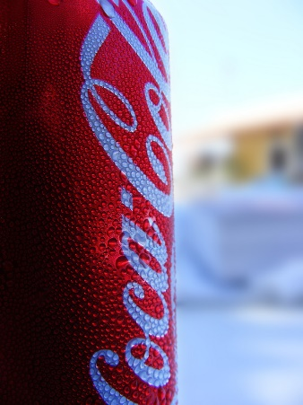
Skill Closure
Substance | Boiling Point (°C)
chloroform | 61.2
methanol | 64.7
nitric acid | 83
sea water | 100.7
sulfuric acid | 337
water | 100
What are the two steps that are used in distillation?
While drinking a can of soft drink, Katie realises that water gradually appear on the sides of the can. She asks you why this is happening. What can you tell her?
Kevin is trying to separate a mixture of chloroform and water, and he wants to keep the chloroform. Should Kevin use distillation to separate the mixture? Explain your answer.
Skill Closure
Vocabulary
dis·till·a·tion (noun) the process of heating a liquid mixture to form gas then cooling that gas to get a liquid con·den·ser (noun) an apparatus for condensing a gas to form a liquid
Skill Closure

Slide 13
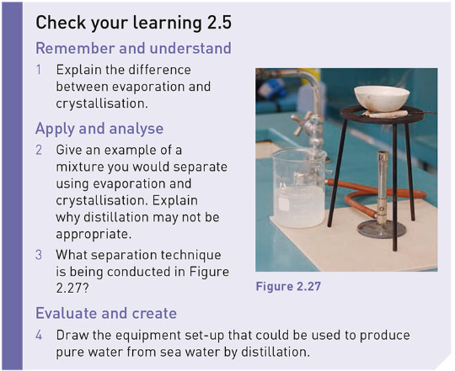
Independent Practice
Complete questions 1 – 3 from page 39 of the text book.

